Slide 1


Overview of IHE IT Infrastructure Integration Profiles
Charles Parisot, GE Healthcare
IHE IT Infrastructure Technical Committee co-chair

Slide 2
More on IHE IT Infrastructure
To learn more about IHE IT Infrastructure
Integrating the Healthcare Enterprise:
www.himss.org/ihe
Read the IHE Fact Sheet

Slide 3
IHE IT Infrastructure
5 Integration Profiles
Retrieve Information
for Display
Retrieve Information
for Display
Enterprise User Authentication
Enterprise User Authentication
Patient Synchronized Applications
Patient Synchronized Applications
Access a patient’s clinical information and documents in a format ready to be presented
to the requesting user
Access a patient’s clinical information and documents in a format ready to be presented
to the requesting user
Synchronize multiple applications on a desktop to the same patient
Synchronize multiple applications on a desktop to the same patient
Provide users a single name
and
centralized authentication process
across all systems
Provide users a single name
and
centralized authentication process
across all systems
Patient Identifier Cross-referencing for MPI
Patient Identifier Cross-referencing for MPI
Consistent Time
Consistent Time
Coordinate time across networked systems
Map patient identifiers across independent identification domains
Coordinate time across networked systems
Map patient identifiers across independent identification domains

Slide 4
IHE IT Infrastructure
5 Integration Profiles
Retrieve Information
for Display
Retrieve Information
for Display
Enterprise User Authentication
Enterprise User Authentication
Patient Synchronized Applications
Patient Synchronized Applications
Access a patient’s clinical information and documents in a format ready to be presented
to the requesting user
Access a patient’s clinical information and documents in a format ready to be presented
to the requesting user
Synchronize multiple applications on a desktop to the same patient
Synchronize multiple applications on a desktop to the same patient
Provide users a single name
and
centralized authentication process
across all systems
Provide users a single name
and
centralized authentication process
across all systems
Patient Identifier Cross-referencing for MPI
Patient Identifier Cross-referencing for MPI
Consistent Time
Consistent Time
Coordinate time across networked systems
Map patient identifiers across independent identification domains
Coordinate time across networked systems
Map patient identifiers across independent identification domains

Slide 5
Retrieve Information for Display
Abstract / Scope
Simple and rapid access to patient information
Access to existing persistent documents in well-known presentation formats: CDA, PDF, JPEG.
Access to specific key patient-centric information for presentation to a clinician : allergies, current medications, summary of reports, etc..
Links with other IHE profiles - Enterprise User Authentication & Patient Identifier Cross-referencing.

Slide 6
Retrieve Information for Display
Value Proposition:
User Convenience:
  Healthcare providers can "see" the information. A significant integration step.
  Workflows from within the users’ on-screen workspace or application.
  Complements multiple simultaneous apps workflow of Patient Synchronized Apps
Broad Enterprise-Wide access to information:
  Web technology for simple clients
  Clinical data handling fully assumed by the information source that holds clinical data.

Slide 7
Retrieve Information for Display
Key Technical Properties:
Standards Used:
  Web Services (WSDL for HTTP Get).
  General purpose IT Presentation Formats: XHTML, PDF, JPEG plus CDA L1.
  Client may be off-the-shelf browser or display application.
Two services :
  Retrieve of Specific Information:
    Patient centric: patient ID
    Type of Request (see next slide)
    Date, Time, nMostRecent
  Retrieve a Document
    Object Unique Instance Identifier (OID)
    Type of Request
    Content Type Expected

Slide 8
Retrieve Information for Display
Transaction Diagram
Display
Retrieve Specific Info for Display [11]
Information
Source
Retrieve Document for Display [12]
Summary of All Reports
Summary of Laboratory Reports
Summary of Radiology Reports
Types of
Requests
Summary of Cardiology Reports
Summary of Surgery Reports
Summary of Intensive Care Reports
Summary of Emergency Reports
Summary of Discharge Reports
List of Allergies
List of Medications
Persistent Document

Slide 9
Query Keys – Transaction [11]
Retrieve Specific Information for Display
Parameter Name
REQ
Description
Request
Type
R
requestType specifies what type of information shall be retrieved. This parameter shall always be valued.
patientID
R
This attribute identifies the subject of the results being queried for. Its value shall include identification of assigning authority.
lowerDate
Time
O
Used to constrain the earliest date/time of creation of information.
upperDate
Time
O
Used to constrain the latest date/time of creation of information.
MostRecentResults
R
The numeric value that indicates the number of most recent results to be included into the response, i.e., 1 indicates to provide the latest result.

Slide 10
Query Keys – Transaction [12]
Retrieve Document for Display
Parameter Name
REQ
Description
Request
Type
R
This parameter is required to have a value of “DOCUMENT”.
Document
UID
R
Identifies document’s UID as known to both actors.
PreferredContentType
R
This parameter is required to identify the preferred format the document is to be provided in (as MIME content type).

Slide 11
IHE IT Infrastructure
5 Integration Profiles
Patient Synchronized Applications
Retrieve Information
for Display
Patient Synchronized Applications
Retrieve Information
for Display
Enterprise User Authentication
Enterprise User Authentication
Access a patient’s clinical information and documents in a format ready to be presented
to the requesting user
Access a patient’s clinical information and documents in a format ready to be presented
to the requesting user
Synchronize multiple applications on a desktop to the same patient
Synchronize multiple applications on a desktop to the same patient
Provide users a single name
and
centralized authentication process
across all systems
Provide users a single name
and
centralized authentication process
across all systems
Patient Identifier Cross-referencing for MPI
Patient Identifier Cross-referencing for MPI
Consistent Time
Consistent Time
Coordinate time across networked systems
Map patient identifiers across independent identification domains
Coordinate time across networked systems
Map patient identifiers across independent identification domains

Slide 12
Patient Synchronized Applications
Abstract / Scope
Patient synchronization of multiple disparate applications
Single patient selection
When combined with PIX Profile, allows patient synchronization across patient identity domains
Not addressed by IHE-Europe in 2004.

Slide 13
Patient Synchronized Applications
Value Proposition:
User Convenience:
  Eliminates the repetitive task of selecting the patient in each application
  Permits the user to select the patient in the application for which they are most familiar and / or appropriate to the clinical workflow
Patient Safety:
  Ensures all data being viewed across applications is for the same patient

Slide 14
Patient Synchronized Applications
Key Technical Properties:
Standards Used:
  HL7 Context Management “CCOW” Standard, Version 1.4
  Support for both Windows and Web Technology
  Support of “Patient Subject”
IHE Constraints:
  Specifies use of Patient.Id.IdList item
    Ensures maximum interoperability with PIX Profile
    Protects against future deprecation of patient identifier items (HL7 2.3.1, 2.4, 2.5, CCOW).

Slide 15
Patient Synchronized Applications
Transaction Diagram

Slide 16
IHE IT Infrastructure
5 Integration Profiles
Retrieve Information
for Display
Retrieve Information
for Display
Enterprise User Authentication
Enterprise User Authentication
Patient Synchronized Applications
Patient Synchronized Applications
Access a patient’s clinical information and documents in a format ready to be presented
to the requesting user
Access a patient’s clinical information and documents in a format ready to be presented
to the requesting user
Synchronize multiple applications on a desktop to the same patient
Synchronize multiple applications on a desktop to the same patient
Patient Identifier Cross-referencing for MPI
Patient Identifier Cross-referencing for MPI
Provide users a single name
and
centralized authentication process
across all systems
Provide users a single name
and
centralized authentication process
across all systems
Consistent Time
Consistent Time
Map patient identifiers across independent identification domains
Map patient identifiers across independent identification domains
Coordinate time across networked systems
Coordinate time across networked systems

Slide 17
Patient Identifier Cross-referencing
Abstract / Scope
Allow all enterprise participants to register the identifiers they use for patients in their domain
Support domain systems’ queries for other systems’ identifiers for their patients
Optionally, notify domain systems when other systems update identifiers for their patients

Slide 18
Patient Identifier Cross-referencing
Value Proposition
Maintain all systems’ identifiers for a patient in a single location
Use any algorithms (encapsulated) to find matching patients across disparate identifier domains
Lower cost for synchronizing data across systems
  No need to force identifier and format changes onto existing systems
Leverages standards and transactions already used within IHE

Slide 19
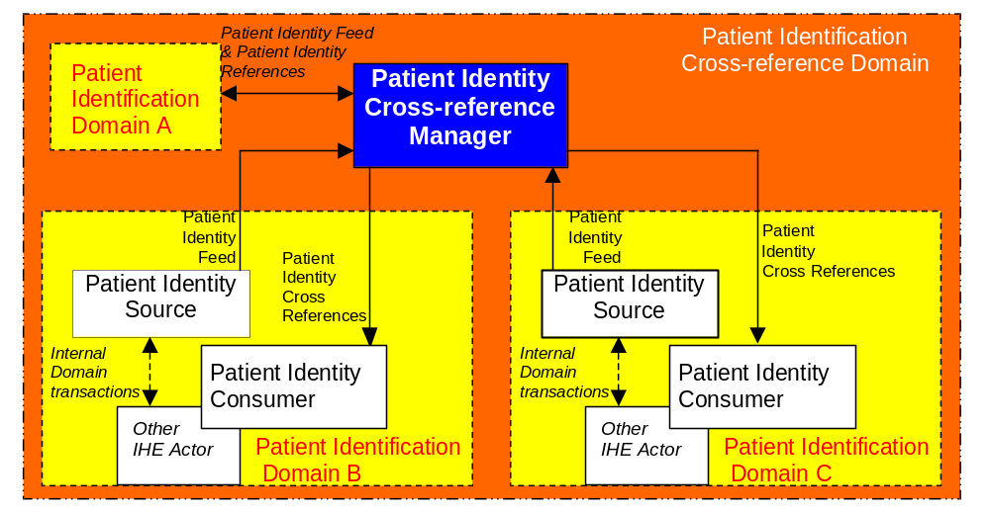
Patient Identifier Cross-referencing
ID Domains & Transactions

Slide 20
Patient Identifier Cross-referencing
Key Technical Properties
Standards Used
  HL7 Version 2.3.1 and Version 2.4
    ADT Registration and Update Trigger Events
      A01: inpatient admission
      A04: outpatient registration
      A05: pre-admission
      A08: patient update
      A40: merge patient
    Queries for Corresponding Identifiers (ADT^Q23/K23)
    Notification of Identifiers Lists Updates (ADT^A31)
Key Properties
  ADTs remain in charge of their domains
  No need for a master ID or MRN, but supported as another ID domain

Slide 21
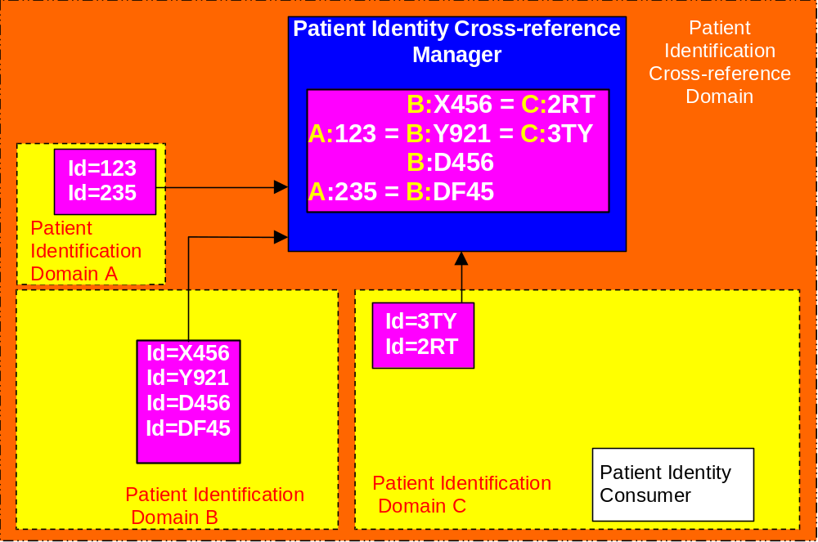
Patient Identifier Cross-referencing
B:X456
C: ?
B:X456
C: 2RT
Patient
Identity
Cross References

Slide 22
Patient Identifier Cross-referencing
Key Benefits
No need for a Master Patient Identifier (facilitates legal constraints).
PIX Manager does not need to produce “consolidated demographics”.
Any Patient Id Domain may be considered as providing “master patient ids” (see next slides).
Patient Demographics is and remains a responsibility of ADTs Actors. In addition to Patient Registration distribution (e.g. Rad & Lab SWF), a Patient Demographics Query Int. Profile is planned

Slide 23
PIX Integration Profile & MPI
Master Patient
Index
Patient Identity Cross-reference Manager
Patient Identification Domain A
(Master Domain)
Master (A) Patient
Identity Source
Patient Identification
Domain B
Patient Identification
Domain C

Slide 24
PIX Integration Profile & MPI
Master Patient
Index
Patient Identity Cross-reference Manager
Patient Identification Domain A
(Master Domain)
Master (A) Patient
Identity Source
Patient Identification
Domain B
Patient Identification
Domain C

Slide 25
IHE IT Infrastructure
5 Integration Profiles
Enterprise User Authentication
Retrieve Information
for Display
Enterprise User Authentication
Retrieve Information
for Display
Patient Synchronized Applications
Patient Synchronized Applications
Access a patient’s clinical information and documents in a format ready to be presented
to the requesting user
Access a patient’s clinical information and documents in a format ready to be presented
to the requesting user
Synchronize multiple applications on a desktop to the same patient
Synchronize multiple applications on a desktop to the same patient
Provide users a single name
and
centralized authentication process
across all systems
Provide users a single name
and
centralized authentication process
across all systems
Patient Identifier Cross-referencing for MPI
Patient Identifier Cross-referencing for MPI
Consistent Time
Consistent Time
Coordinate time across networked systems
Map patient identifiers across independent identification domains
Coordinate time across networked systems
Map patient identifiers across independent identification domains

Slide 26
Enterprise User Authentication
Abstract / Scope
Support a single enterprise governed by a single set of security policies and having a common network domain.
Establish one name per user that can then be used on all of the devices and software in a healthcare enterprise.
Facilitate centralized user authentication management.
Provide users with single sign-on.

Slide 27
Enterprise User Authentication
Value Proposition
Start at the beginning
  Recognize user authentication as a necessary step for most application and data access operations.
  Enable benefits from future integration profiles, such as authorization management.
Achieve cost savings/containment.
  Centralize user authentication management.
  Simplify multi-vendor implementations
Provide workflow improvement for users.
  Increase user acceptance.
  Decrease unproductive user task-switching time.
Increase level of assurance in security protection.

Slide 28
Enterprise User Authentication
Key Technical Properties
Standards Used
  Kerberos v5 (RFC 1510)
    Stable since 1993,
    Widely implemented on current operating system platforms
    Successfully withstood attacks in its 10-year history
    Fully interoperable among all platforms
  HL7 CCOW user subject
Minimal Application Changes
  Eliminate application-specific, non-interoperable authentication.
  Replace less secure proprietary security techniques.

Slide 29
Enterprise User Authentication
Transaction Diagram

Slide 30
Enterprise User Authentication
Transaction Diagram (+CCOW Option)

Slide 31
Enterprise User Authentication
Key Benefits
Limited overhead as there is no need for transactions between the Kerberized Server and the Authentication Server (only configuring the proper certificate).
Kerberos protocol defined to work with any user authentication technique. Supports a wide variety of authentication technologies (tokens, biometric technologies, smart cards). Specific implementations require a pair of proprietary components added – one at the user workstation and a matching component at the authentication server. Once the user authentication is complete, the subsequent Kerberos transactions are the same.

Slide 32
IHE IT Infrastructure
5 Integration Profiles
Retrieve Information
for Display
Retrieve Information
for Display
Enterprise User Authentication
Enterprise User Authentication
Patient Synchronized Applications
Patient Synchronized Applications
Access a patient’s clinical information and documents in a format ready to be presented
to the requesting user
Access a patient’s clinical information and documents in a format ready to be presented
to the requesting user
Synchronize multiple applications on a desktop to the same patient
Synchronize multiple applications on a desktop to the same patient
Consistent Time
Consistent Time
Provide users a single name
and
centralized authentication process
across all systems
Provide users a single name
and
centralized authentication process
across all systems
Patient Identifier Cross-referencing for MPI
Patient Identifier Cross-referencing for MPI
Coordinate time across networked systems
Coordinate time across networked systems
Map patient identifiers across independent identification domains
Map patient identifiers across independent identification domains

Slide 33
Consistent Time
Scope and Value Proposition
Ensures that the system clocks and time stamps of the many computers in a network are well synchronized
A median error under 1 second is sufficient for most purposes.
Consistent Time profile specifies the use of the Network Time Protocol (NTP) defined in RFC 1305.

Slide 34
IHE IT Infrastructure
5 Integration Profiles
Retrieve Information
for Display
Retrieve Information
for Display
Enterprise User Authentication
Enterprise User Authentication
Patient Synchronized Applications
Patient Synchronized Applications
Access a patient’s clinical information and documents in a format ready to be presented
to the requesting user
Access a patient’s clinical information and documents in a format ready to be presented
to the requesting user
Synchronize multiple applications on a desktop to the same patient
Synchronize multiple applications on a desktop to the same patient
Provide users a single name
and
centralized authentication process
across all systems
Provide users a single name
and
centralized authentication process
across all systems
Patient Identifier Cross-referencing for MPI
Patient Identifier Cross-referencing for MPI
Consistent Time
Consistent Time
Coordinate time across networked systems
Map patient identifiers across independent identification domains
Coordinate time across networked systems
Map patient identifiers across independent identification domains

Slide 35
Synergy between IHE IT Int. Profiles
RID with EUA/CT & PIX
Example of support of
multiple actors/profiles
Patient Identity X-ref Manager
Display
Information Source
Client Authentication
Agent
Patient Identity Consumer
Time Client
Kerberos
Authentication
Server
Time
Server

Slide 36
Synergy between IHE IT Int. Profiles
Apps with PSA, EUA & PIX
Patient Identity X-ref Manager
Example of support of
multiple actors/profiles
Application B
Context participant
Patient Identity Consumer
Application A
Context participant
Context Manager
Client Authentication
Agent
Time Client
Kerberos
Authentication
Server
Time
Server

Slide 37
How to proceed with IHE IT Infra
  Read IHE Fact Sheet & this presentation
    www.himss.org/ihe
  Read ITI Technical Framework Vol 1 Integration Profiles
    www.himss.org/ihe
  Read ITI Technical Framework Vol 2 Transactions
    www.himss.org/ihe
  IHE IT Infrastructure Tech. Committee has issued the trial for implementation technical framework in August for HIMSS HL7-IHE and IHE-Europe Connectathons.
  Final IT Infrastructure Technical Framework to be issued in April 2004.

Slide 38
Overview of Supplements to be specified in 2004
Charles Parisot, GE Healthcare
IHE IT Infrastructure Technical Committee co-chair

Slide 39
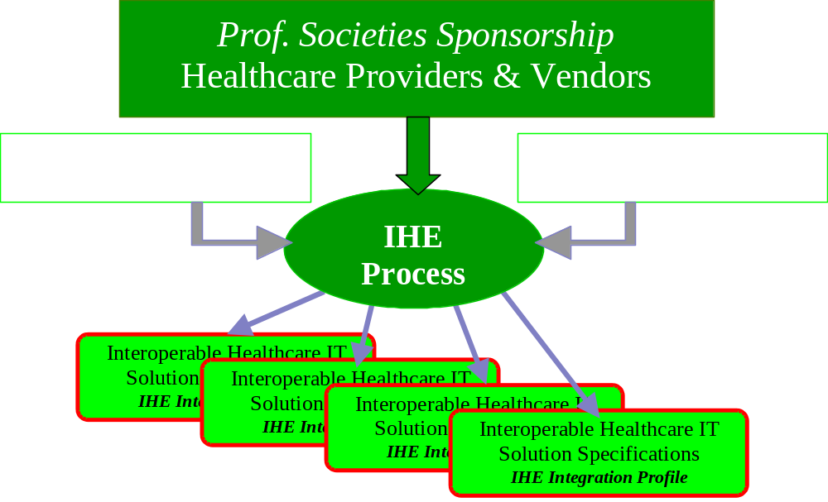
IHE drives healthcare standards based-integration

Slide 40
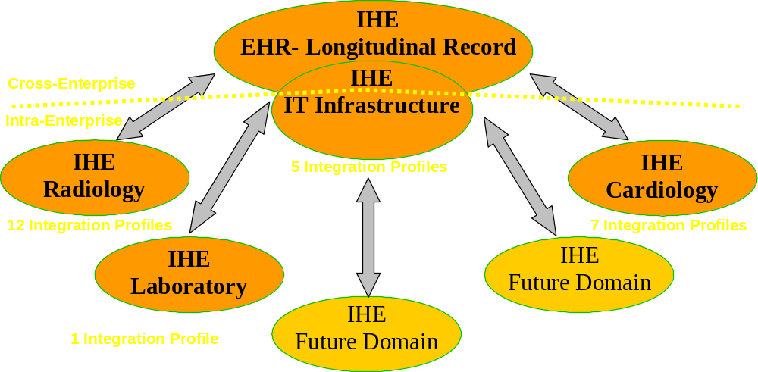
IHE 2003 achievements and expanding scope
Over 80 vendors involved world-wide, 4 Technical Frameworks
25 Integration Profiles, Testing at yearly Connectathons,
Demonstrations at major exhibitions world-wide
Provider-Vendor cooperation to accelerate standards adoption

Slide 41
IHE Process
Users and vendors work together to identify and design solutions for integration problems
Intensive process with annual cycles:
  Identify key healthcare workflows and integration problems
  Research & select standards to specify a solution
  Write, review and publish IHE Technical Framework
  Perform cross-testing at “Connectathon”
  Demonstrations at tradeshows (HIMSS/RSNA…)
Notes:
**Consider making the cycle graphic
Incremental approach: Can’t solve all at once
Connectathon – Practical measure of progress, Validates the integration work accomplished. Refer the Scorecard.
Demo – promotes standards based integration to users/purchasers

Slide 42
A Proven Standards Adoption Process
Product IHE Integration
Statement
IHE Connectathon
Results
IHE
Connectathon
IHE
Demonstration
IHE
Technical
Framework
Product
With IHE
Easy to
Integrate
Products
Standards
IHE
Integration
Profiles B
IHE
Integration
Profile A
User Site
RFP
IHE Integration Profiles at the heart of IHE :
  Detailed selection of standards and options each solving a specific integration problem
  A growing set of effective provider/vendor agreed solutions
  Vendors can implement with ROI
  Providers can deploy with stability

Slide 43
IHE IT Infrastructure – Plan for 2004-2005
IT Infrastructure Development Plan:
  IHE ITI Planning Committee decision: mid-February
  Issue Public Comment version: June 2004
  Public Comment Due: July 2004
  Issue Trial Implementation version: August 2004
  IHE Connectathon: January 2005
  HIMSS Demo: February 2005
Profiles under consideration:
  EHR-Cross-Enterprise Document Sharing
  Patient Demographics Query
  Audit Trail and Node Authentication
  White Page Directory
  Code Sets Distribution

Slide 44
IHE Authentication and Audit
Scope
  Authentication is node-to-node
    Ensures only permitted devices connect to network
    User authentication covered by the EUA profile or local procedures.
  Audit includes:
    General security events such as logins, file access, and detection of unauthorized activity
    Healthcare privacy events such as access to patient data and applications.
    Support for a central repository for audit review.

Slide 45
IHE Authentication and Audit
Key technical properties
  Node-to-node authentication uses X.509 certificates, but PKI is not specified by IHE yet.
  Audit messages use a standardized XML format (IETF RFC Pending)
  Transport for audit messages may use syslog or reliable syslog
  Backwards compatibility with IHE Radiology (year 2002) is preserved.

Slide 46
Code Set Distribution
Scope
Lab Reporting
Code Set
Source
Lab Procedure List
ICD Code List
Radiology
Approved Formulary List
Pharma
Provide site specific code lists to systems
in a standard manner.

Slide 47
Code Set Distribution
Technical Properties
LDAP based code set location service
HTTP based requests of code sets
XML encoded code set format
A code set is:
  Client application defined semantics
  Identified by an OID (and a user friendly name)
  Codes may come from any vocabulary source

Slide 48
Patient Demographics Query
Abstract/Scope
Allow quick retrieval of common patient name, identifier, and location in a standard manner at the point of care.
Enable selection of correct patient when full identification data may not be available
Protect patient- and enterprise-sensitive clinical information

Slide 49
Patient Demographics Query
Key Technical Properties
Employs HL7 Conformance Based Queries
  Defined in HL7 Version 2.5, Chapter 5
  Query by Parameter (QBP) with Segment Pattern Response (RSP)
User enters identifiers for patients of interest
Server returns information in HL7 V2.5 patient data segments.

Slide 50
White Pages Directory
Scope
Lab Reporting
White
Pages
Server
Healthcare Staff Info
Healthcare Staff Info
Electronic
Medical
Records
Healthcare Staff Info
Pharma
Provide access to healthcare staff information
to systems in a standard manner.

Slide 51
White Pages Directory
Technical Properties
LDAP based directory location service
LDAP based requests of person info
Leverages InetPerson in LDAP

Slide 52
EHR Cross-Enterprise Document Sharing
Scope
First step towards the longitudinal dimension of the EHR:
Focus: Clinical Information Exchange between EHRs in care settings to communicate with a distributed longitudinal EHR.
Goal: Meet a broad range of EHR-LR (Longitudinal Record) needs with a distributed,
cross-enterprise,
document centric
document content generic

Slide 53
Continuity of Care: Patient Longitudinal Record Across Care Deliveries
Acute Care (Inpatient)
Nursing Homes
Other Specialized Care
or Diagnostics Services
A typical patient goes through a sequence of care episodes in different Care Setting (incl. Diagnostics Services).
GPs and Clinics (Outpatient)

Slide 54
Integration : Feeding & Accessing the Longitudinal Health Record Information
EHR-LR
Acute Care (Inpatient)
Nursing Homes
EHR-CR
EHR-CR
Other Specialized Care
or Diagnostics Services
EHR-CR
EHR-CR
GPs and Clinics (Outpatient)
The EHR-LR (Longitudinal Record) brings together
patient information managed by multiple care delivery systems

Slide 55
Use Case 1 : “EHR-LR with Source Repository”
An EHR-CR completes a phase of care for a patient for which it decides to:
  Register a set of documents (newly created and priors of interest documents) with an EHR-LR Directory Actor.
  Keep these documents in an EHR-LR Repository Actor.
Any other EHR-CR may query an EHR-LR Directory Actor, find out about documents related to all phases of care for the patient and chose to retrieve some of these documents from any EHR-LR Repository Actor (Used in use Case 1 & 2).
3b Notification confirm
3a Notification
2
Register (Notif)
EHR-LR
Directory
EHR-CR
Source
Query
EHR-CR
Consumer
EHR-LR
Repository
Retrieve

Slide 56
Use Case 2 : “EHR-LR with Third Party Repository”
An EHR-CR completes a phase of care for a patient for which it decides to:
  Register a set of documents (newly created and priors of interest documents) with an EHR-LR Directory Actor.
  Provides these documents to an EHR-LR Repository Actor.
Any other EHR-CR may query an EHR-LR Directory Actor, find out about documents related to all phases of care for the patient and chose to retrieve some of these documents from any EHR-LR Repository Actor (Used in use Case 1 & 2).
3b Notification confirm
3a Notification
2
Register (Notif)
EHR-LR
Directory
EHR-CR
Source
Query
EHR-CR
1
Provide-Transfer
Retrieve
EHR-LR
Repository

Slide 57
Use Case 3: “Direct Patient Transfer-Referral”
An EHR-CR completes a phase of care for a patient for which it decides to:
  Register and Provide an EHR-CR Recipient Actor that a specific set of documents (newly created and priors of interest documents) are available from an EHR-LR Repository
The EHR-CR Recipient Actor receive both the registration and the documents.
EHR-CR
EHR-CR
Source
2
Register(Notif)
EHR-LR
Directory
1
Provide/transfer
EHR-CR/LR
Repository

Slide 58
EHR Cross-Enterprise Document Sharing
Key Technical properties
Leverage HL7 CDA
The proposed strategy addresses one of the key integration problems in the realization of the EHR vision. IHE does not claim to master and address the definition and all aspects of a complete and interoperable EHR System.
In collaboration with well established standards bodies and other EHR related initiatives world-wide (EHRCOM, CCR, HL7, etc.), IHE expects to contribute at a more cost-effective and rapid deployment.

Slide 59
IHE IT Infrastructure – Plan for 2004-2005
IT Infrastructure Development Plan:
  IHE ITI Planning Committee decision: mid-February
  Issue Public Comment version: June 2004
  Public Comment Due: July 2004
  Issue Trial Implementation version: August 2004
  IHE Connectathon: January 2005
  HIMSS Demo: February 2005
Profiles under consideration:
  EHR-Cross-Enterprise Document Sharing
  Patient Demographics Query
  Audit Trail and Node Authentication
  White Page Directory
  Code Sets Distribution

Slide 60
IHE IT Ca rdiology – Plan for 2004-2005
IT Cardiology Development Plan:
  IHE Card Planning Committee decision: mid-February
  Issue Public Comment version: July 2004
  Public Comment Due: August 2004
  Issue Trial Implementation version: September 2004
  IHE Connectathon (USA): January 2005
  IHE Connectathon (EU): March 2005
  ACC Demo: March 2005
  ESC Demo: August 2005
Profiles under consideration:
  CathLab Workflow
  EchoLab Workflow
  Enterprise ECG Reports Access
  Cardiology Guidelines Access
  Audit Trail and Node Authentication
  Patient Id Cross-Referencing

Slide 61
IHE Radiology – Plan for 2004-2005
Radiology Development Plan:
  IHE Rad Planning Committee decision: mid-October
  Issue Public Comment version: February 2004
  Public Comment Due: March 2, 2004
  Issue Trial Implementation version: April 2004
  IHE Connectathon (USA): January 2005
  IHE Connectathon (EU): March 2005
Supplements under development:
  Imaging Patient Record on Media
  Appointment Notification (SWF Option)
  Report Report (HL7 V2-OBX) (SINR Option)
  Instance Availability Notification
  White Paper on Departmental Workflow

Slide 62
IHE Laboratory – Plan for 2004-2005
Laboratory Development Plan:
  IHE Lab Planning Committee decision: May 2004
  Issue Public Comment version: August 2004
  Public Comment Due: September, 2004
  Issue Trial Implementation version: October 2004
  IHE Connectathon (USA): January 2005
  IHE Connectathon (EU): March 2005
Supplements under discussion:
  Lab Patient Info Reconciliation
  Point of Care Testing
  Lab Analyzer Management
  Lab Report Access
  Cross-enterprise Testing

